Slide 1
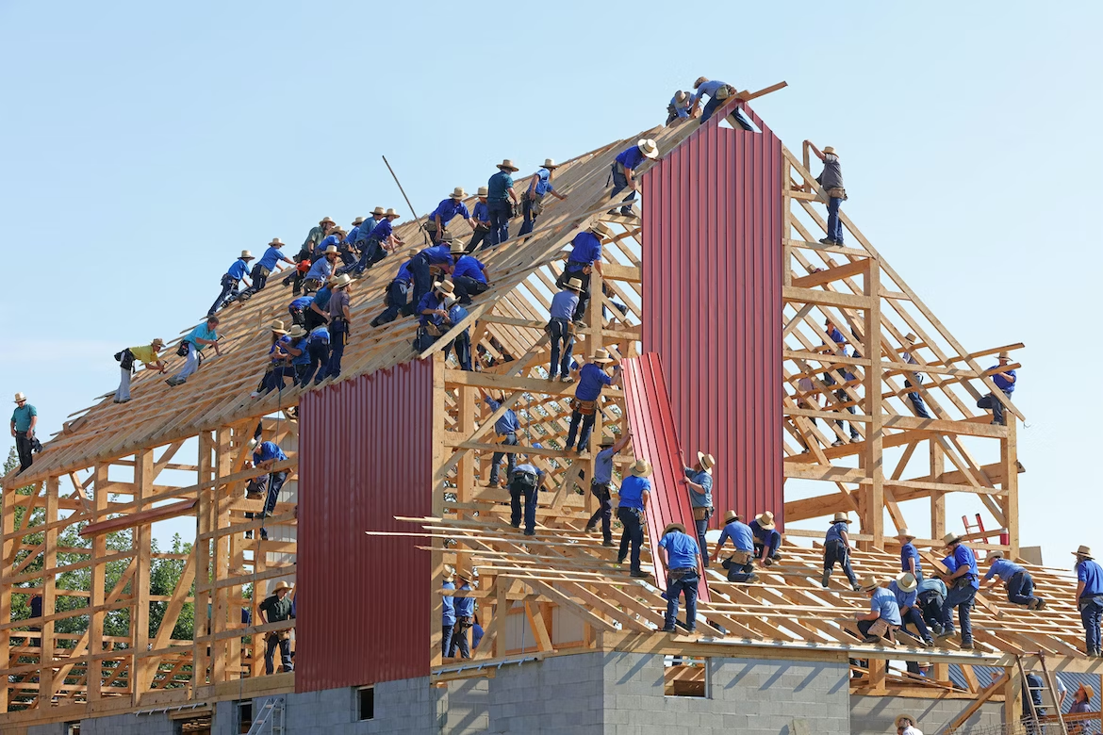
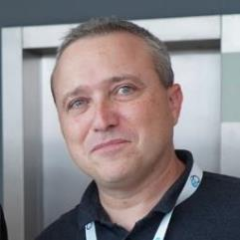

Thomas Froment
Co-Founder CTO
Massive Cooperation Framework (MCF)
Module - Engagement level
Inner Source Inter-Enterprise Group
June 8th 2023

Slide 2
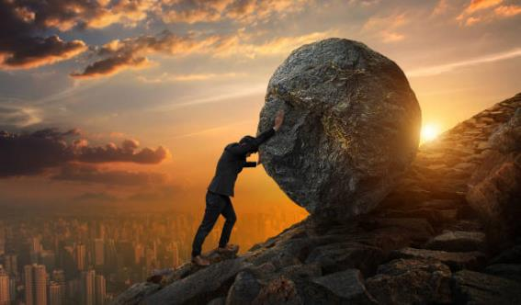

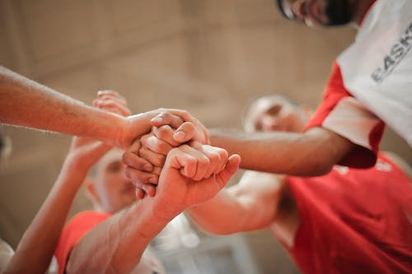
WHY ?

Slide 3


GREAT GOAL
An ecosystem of + 50 companies, schools and foundations, involving 1000 contributors to the Massive Cooperation Framework by 2030

Slide 4







MCF from the field Value For MEMBERS? Value For THE COMPANY? VALUE FOR INTERNAL SPONSORS? OPERATING MODEL? Engagement?
Members
Company (Institution)
Come join my community, it's really awesome!
Mike
Karl
But my members don’t have time!
But managers don’t get all the potential!
Jenny
ISPO Lead

Slide 5
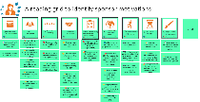


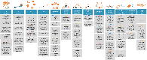
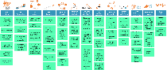





MCF from the field Advocating the Strategic Value of an ISPO →
SLIDES :
https://github.com/tfroment/public-presentations/raw/main/AdvocatingStrategicValueOfAnISPO.pptx
Requested Value
Provided Value
Members
Sponsors
Company
https://www.youtube.com/watch?v=_2sK7hPITDU

Slide 6


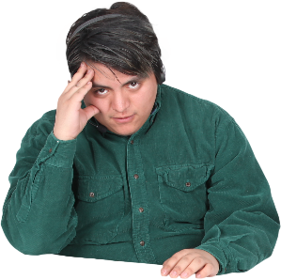
MCF from the field Engagement level EXAMPLE
Why you don’t organize more events, I am starting to get bored
You are asking too much, I am tired
Bob (community member)
Carol
Program Community Lead
Alice
(Community member)

Slide 7
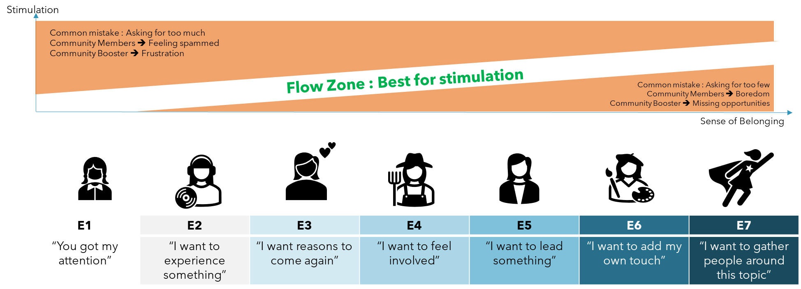
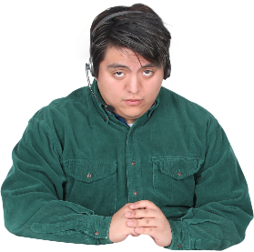


MCF from the field Engagement level READING GRID
Bob
Alice
Carol

Slide 8
MCF from the field Engagement level WHAT is IN THE FRAMEWORK
SLIDES:
https://github.com/tfroment/public-presentations/raw/main/Key%20OSG%20Community%20Workshops%20W3%20Engagement%20level%20Workshop%202.0.pptx

Slide 9
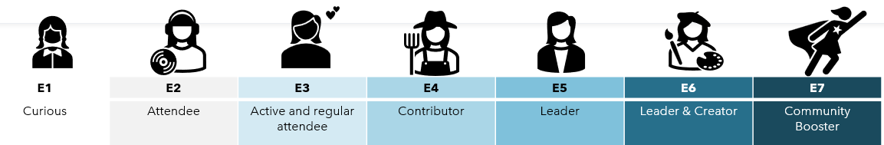



MCF from the field Engagement level MORAL OF THE STORY
Bob
Alice
Carol
Do not assume that all members of a community can have the same level of engagement.
Adapt what is being offered to the engagement level of the members.

Slide 11
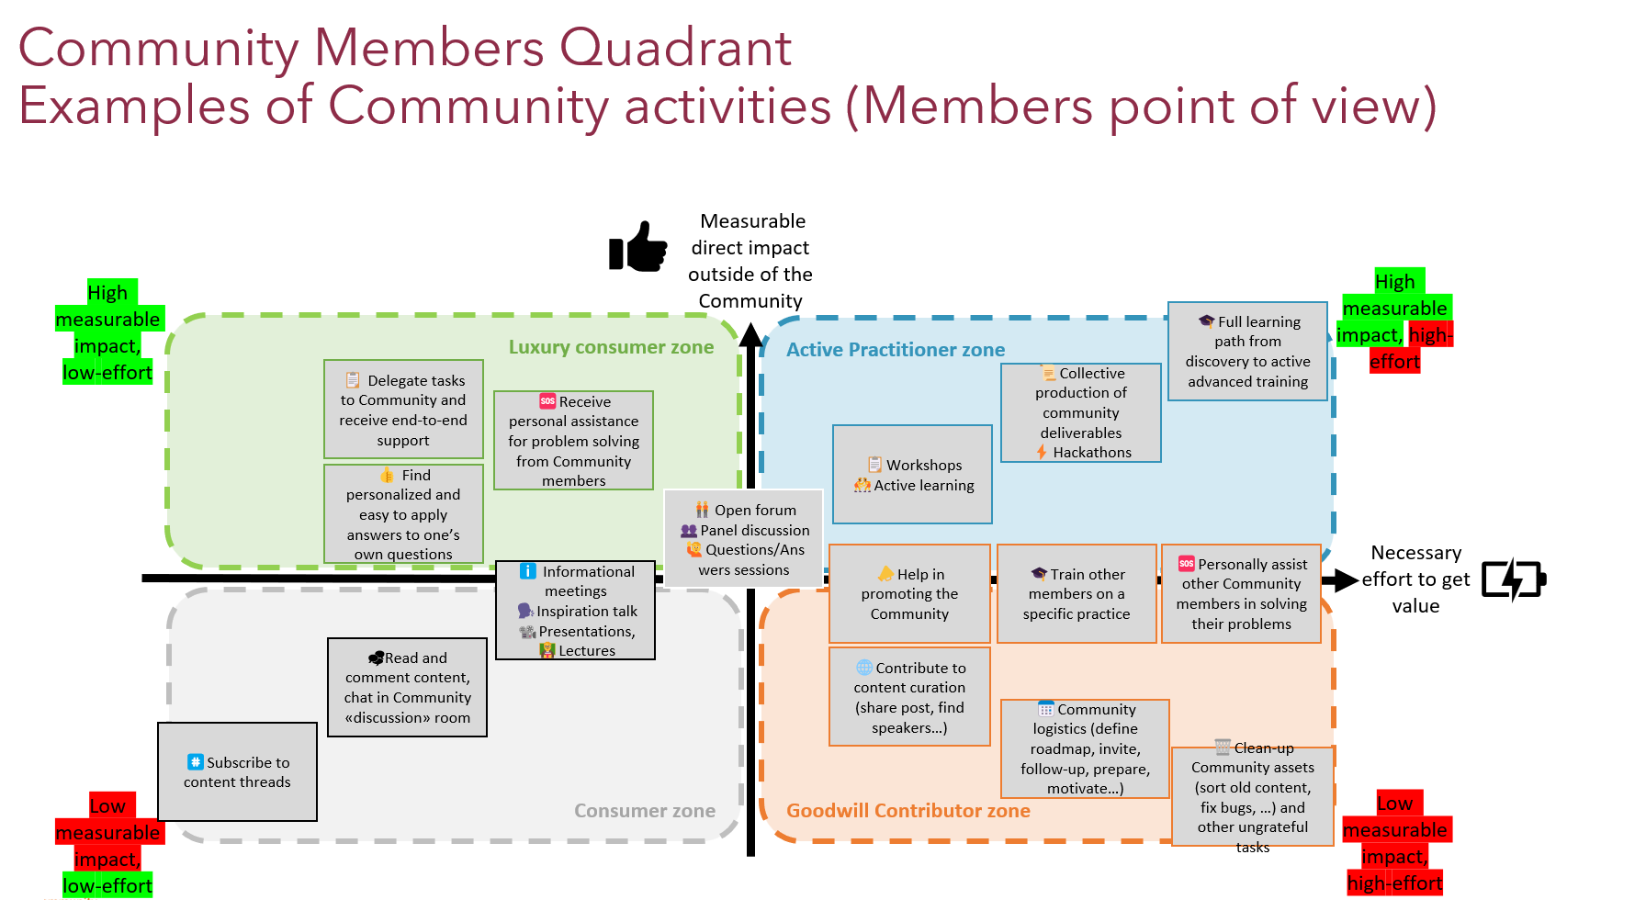

Slide 12
Massive Cooperation Framework
Much more than
what you saw today

Slide 13
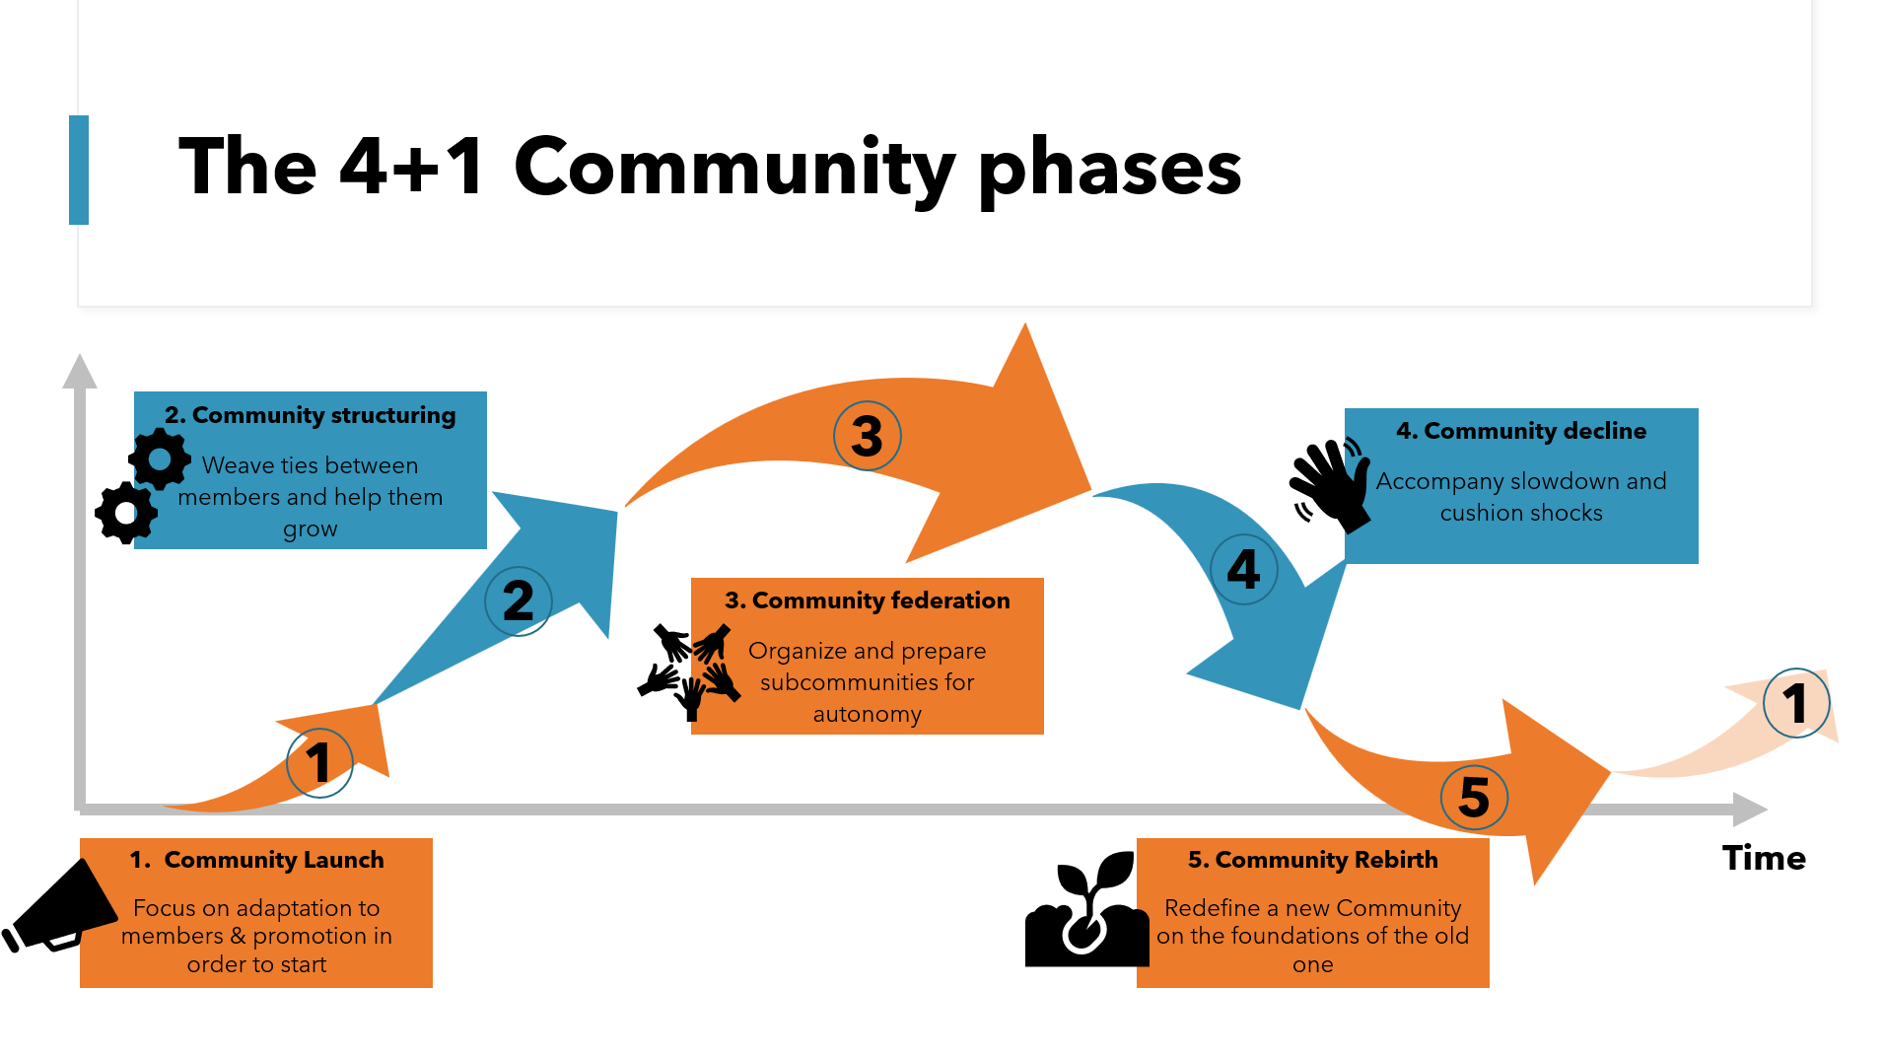
Massive Cooperation Framework
Much more than
what you saw today

Slide 14
Massive Cooperation Framework
Much more than
what you saw today

Slide 15
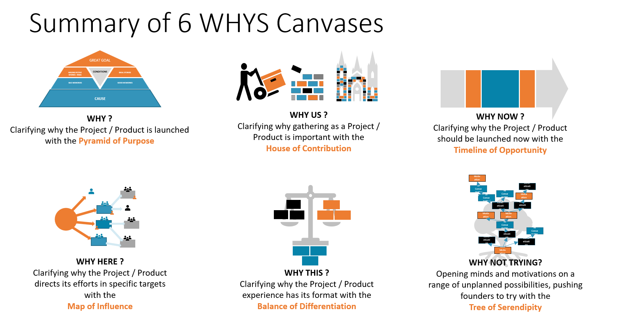
Massive Cooperation Framework
Much more than
what you saw today

Slide 16
Massive Cooperation Framework
Much more than
what you saw today

Slide 17
Massive Cooperation Framework
Much more than
what you saw today

Slide 18
Massive Cooperation Framework
Much more than
what you saw today

Slide 19
Massive Cooperation Framework
Much more than
what you saw today

Slide 20
Massive Cooperation Framework
Much more than
what you saw today

Slide 21
Massive Cooperation Framework
Much more than
what you saw today

Slide 22
Massive Cooperation Framework
Much more than
what you saw today

Slide 23
Massive Cooperation Framework
Much more than
what you saw today

Slide 24
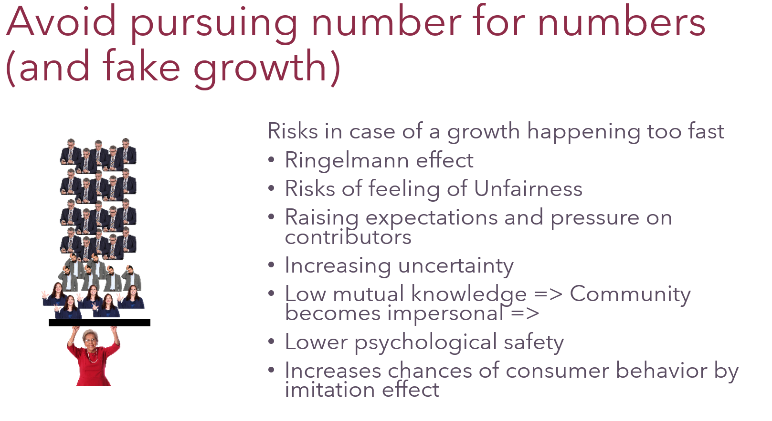
Massive Cooperation Framework
Much more than
what you saw today

Slide 25
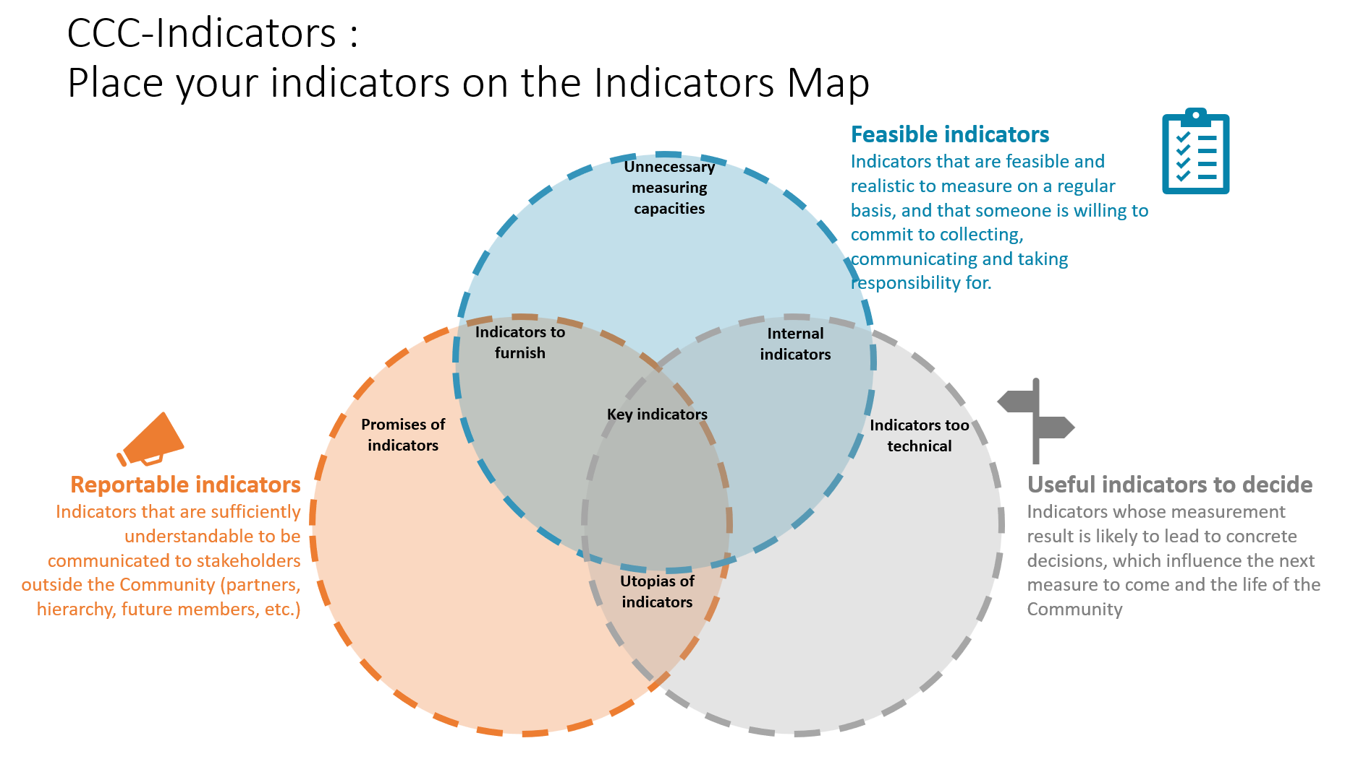
Massive Cooperation Framework
Much more than
what you saw today

Slide 26

In SHort

Slide 27
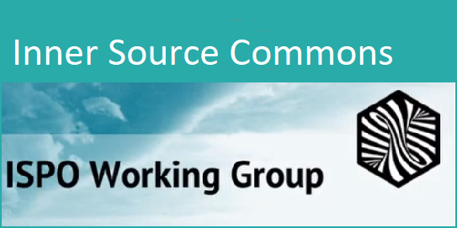

WHAT’s Next
https://github.com/InnerSourceCommons/ispo-working-group
Partial (and mainly FR) content of MCF (May 2023): https://openseriousgames.org/openseriouscommunity/
Coming soon – (Sept 2023)
Open Source (CC BY 4.0) contributive framework on Github

Slide 28

Questions

